Slide 1
Galvanized Midterm Project
Ultra Marathon Running
Presented by: Justin Welch
DAI Cohort 10
justin.d.welch2@gmail.com

Slide 2
Agenda
Overview
Objective
Data Sources and Transformations
Visualizations Needed
Results and Key Insights
Recommendations
Future Study

Slide 3
Overview
Ultra Marathon Running Data
Cleaning
Merging
Analyzing
Key Findings of Data and Questions

Slide 4
Objectives
Does Elevation average of states or elevation gain have a factor in race times?
Do race times get better over the years from 1963 to 2022?
What are the states with the average race paces that are higher?
Is age associated to running faster with elevation gain?
What is the fastest running time per minimum and maximum elevation gain by state?
Find the correlation between age and race location(state) along with the time it takes to run the races (hours). Is there a correlation?

Slide 5
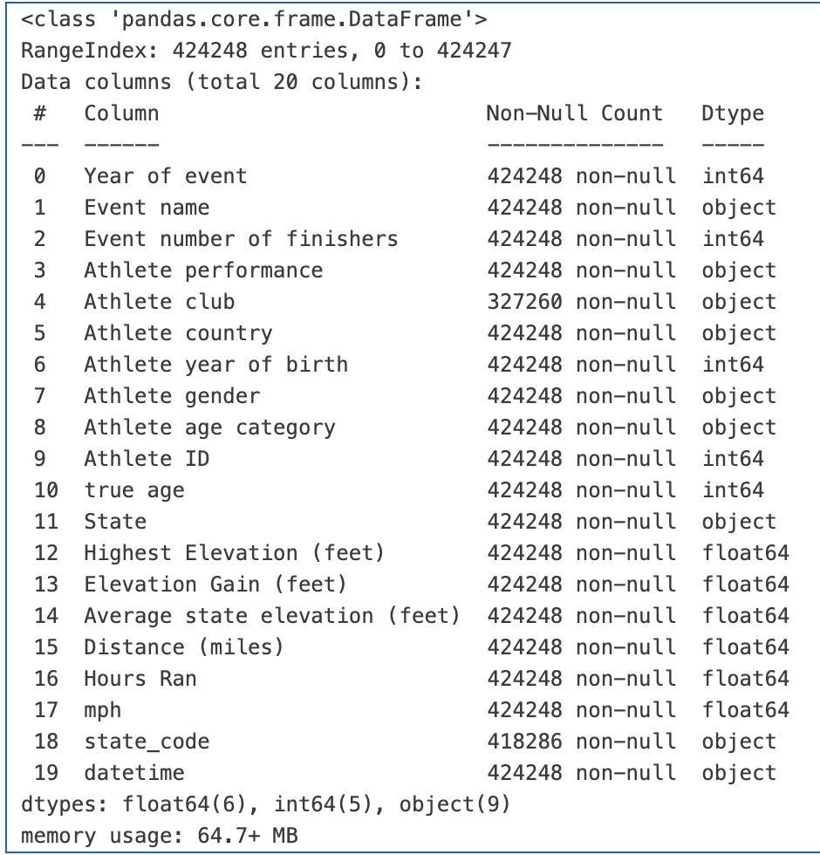
Data Sources and Transformations
Kaggle - Open source with data tables
Ultrasignup - Ultra Marathon Information
OpenStreetMap / Google Maps
Wikipedia - State information
Cleaned and merged data from multiple sources. The transformation cleaned the data to pull the 100 Top Ultra Marathon Events by distance from 1963 to 2022.

Slide 6
Visualizations Needed
Scatter Plots
Bar Charts
Line Plots
Box Plots
Choropleth
Folium Map
Correlation Matrix

Slide 7
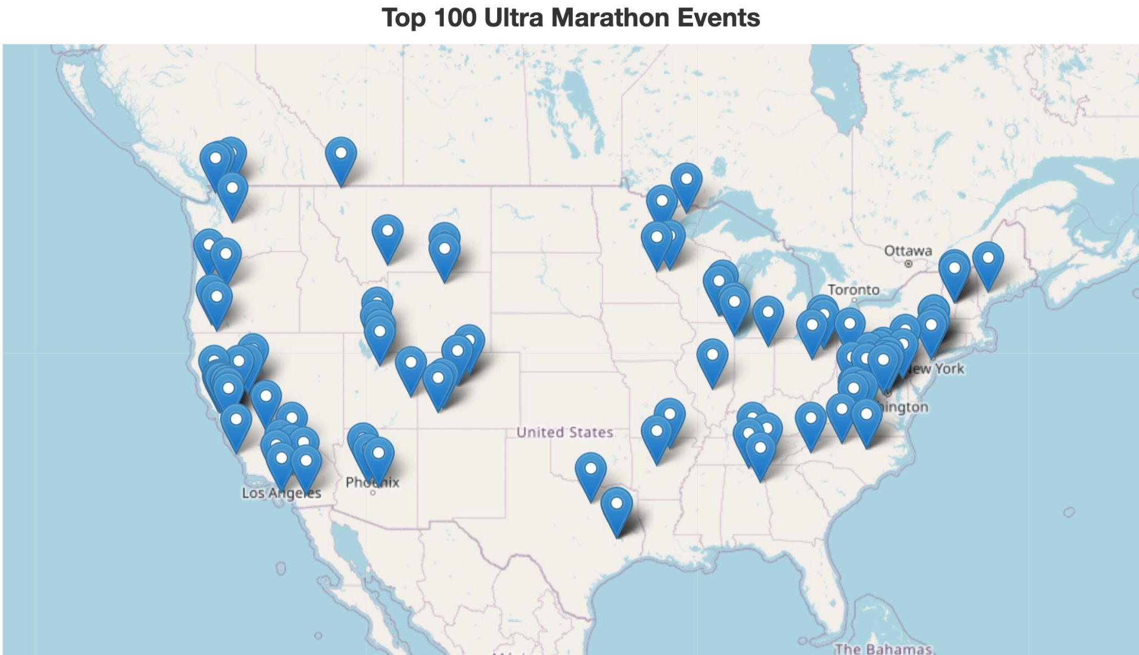

Slide 8
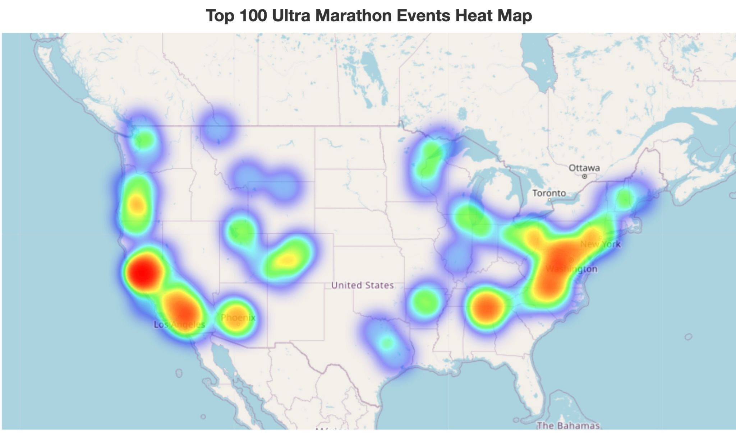

Slide 9
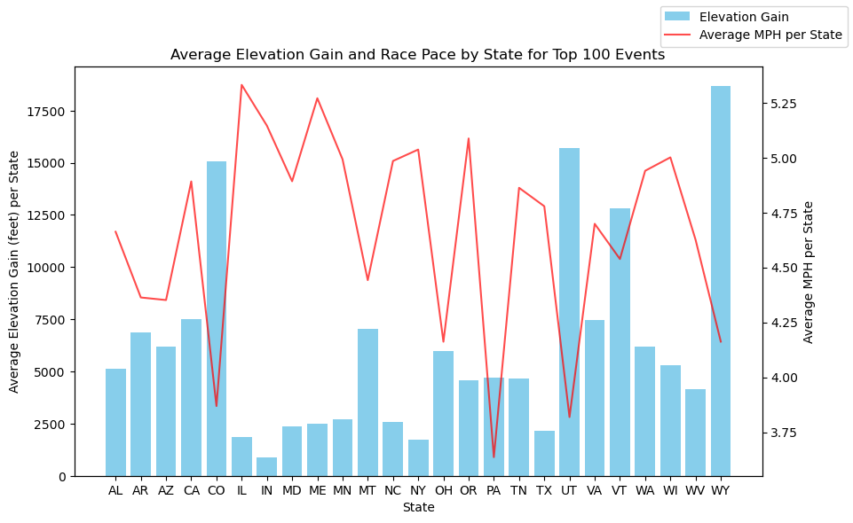
Does Elevation average of states or elevation gain have a factor in race times?

Slide 10
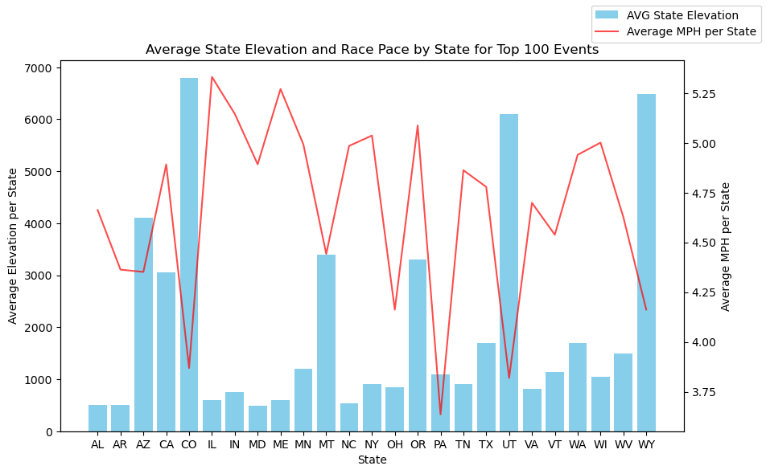

Slide 11
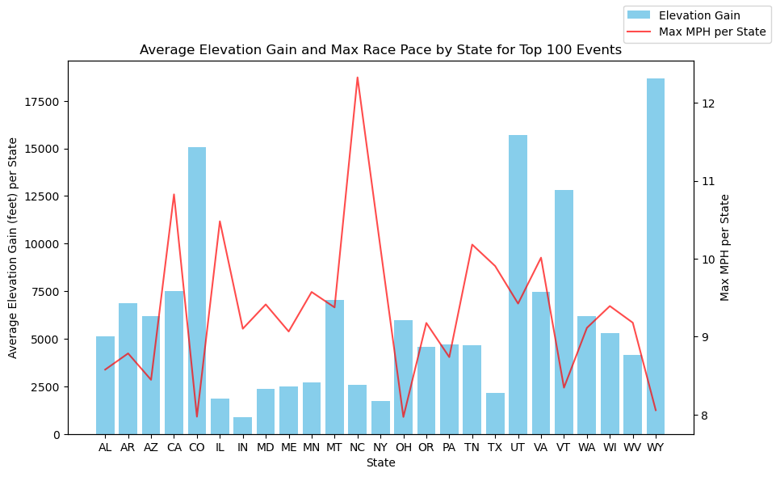
Does Elevation average of states or elevation gain have a factor in race times?
Yes, Elevation Gain has a factor in running pace.

Slide 12
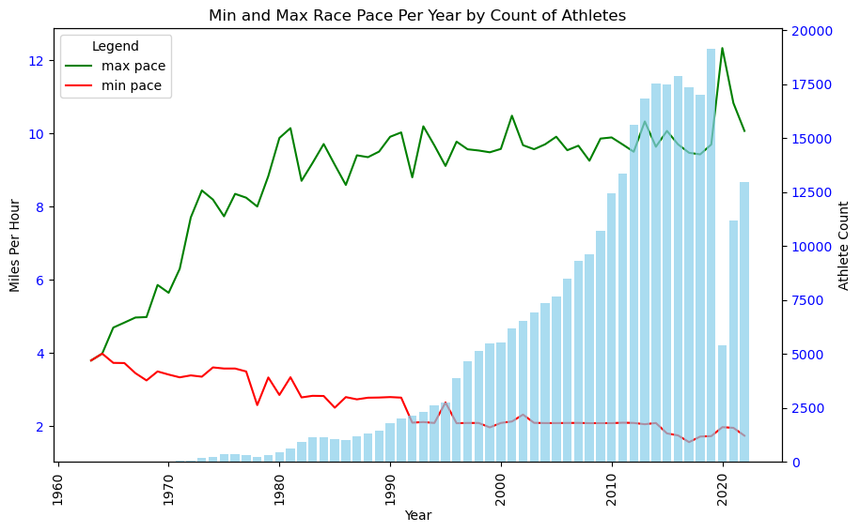
Do race times get better over the years from 1963 to 2022?
Average Max Pace is consistent over the years. More athletes shows a decrease in min pace time.

Slide 13
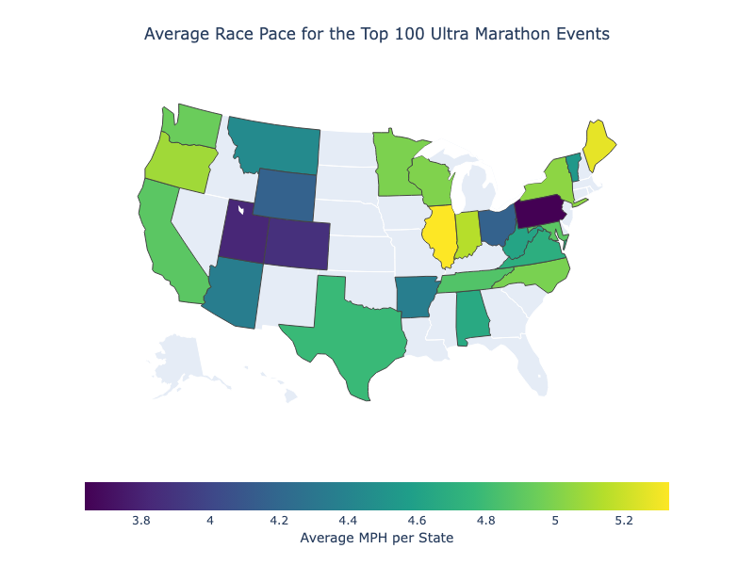
What are the states with the average race paces that are higher?
Higher average race pace for running are in Illinois and Maine.

Slide 14
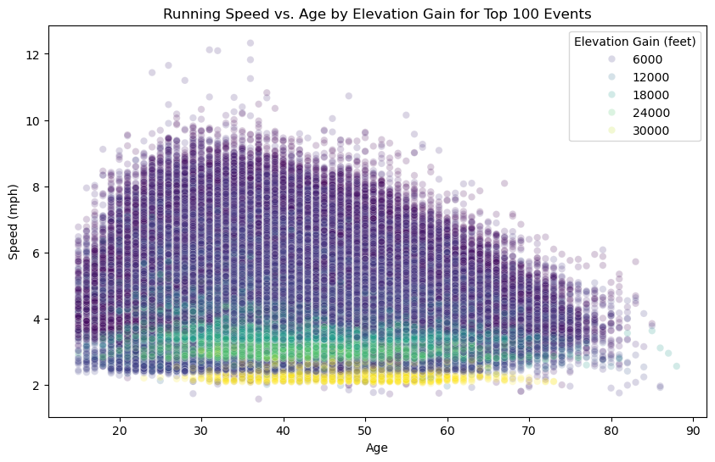
Is age associated to running faster with elevation gain?
Age is associated to running faster with elevation gain, however, with maximum elevation gain age is not a factor.

Slide 15
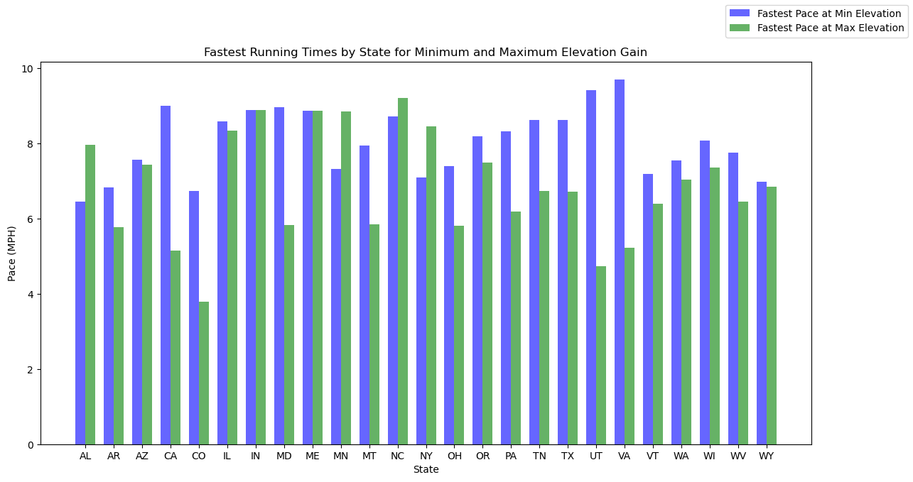
What is the fastest running time per minimum and maximum elevation gain by state?
North Carolina for fastest at Max Elevation
Virginia for fastest at Min Elevation

Slide 16
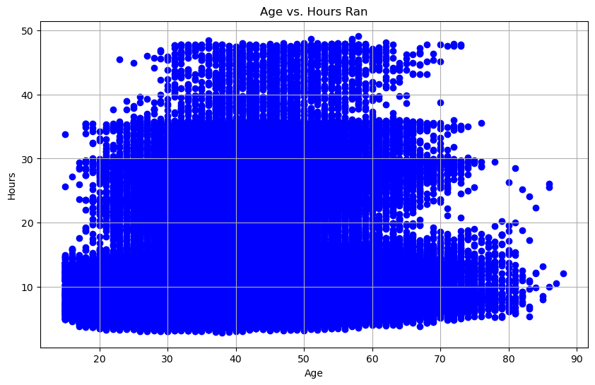
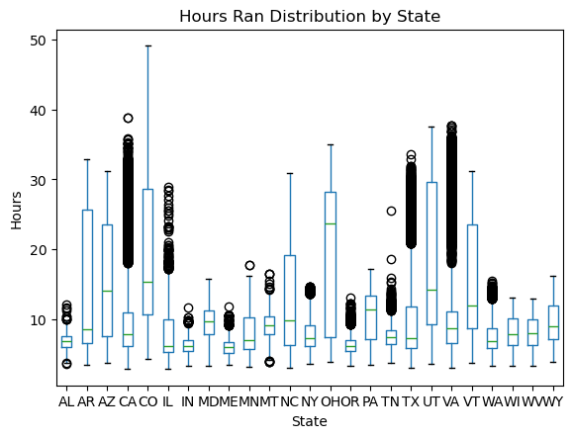
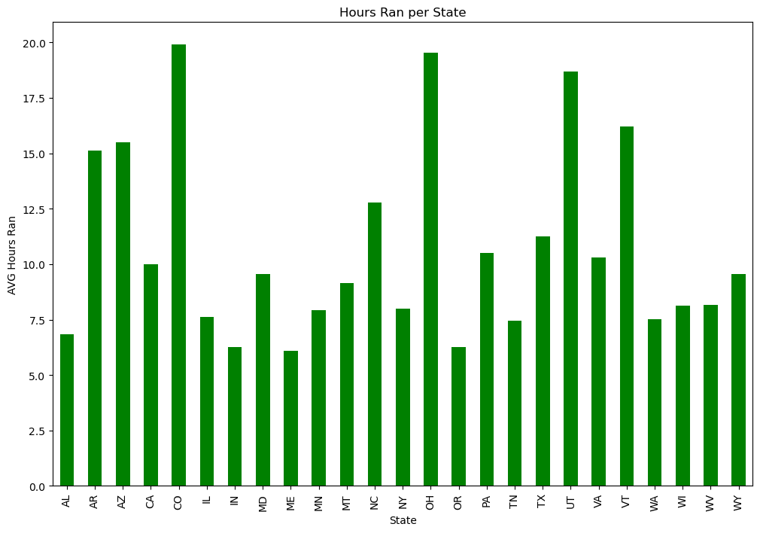
Find the correlation between age and race location(state) along with the time it takes to run the races (hours). Is there a correlation?

Slide 17
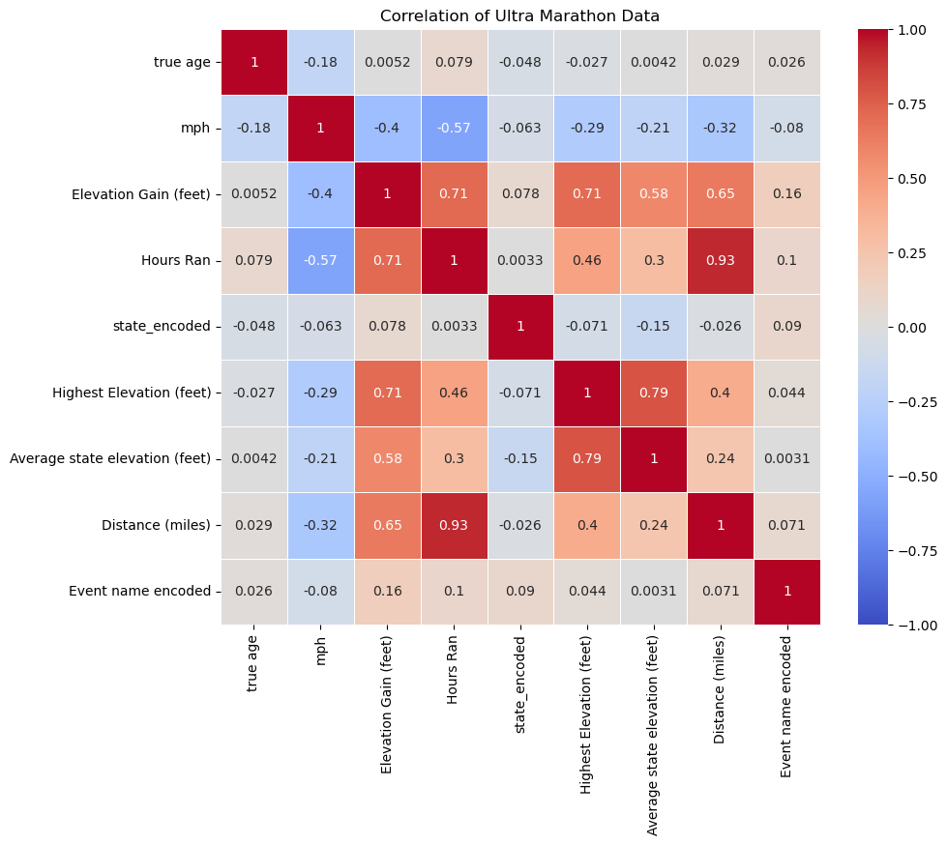
Find the correlation between age and race location(state) along with the time it takes to run the races (hours). Is there a correlation?
There are no direct correlations for age, race location, and hours ran in a race. There are more positive correlations between hours ran, distance, and Elevation.

Slide 18
Recommendations and Future Study
Recommend breaking out the data by distance due to ultra marathon races being anywhere from 26.3 miles and up. i.e. data by 50km races to 100 mile races.
Consider studying Terrain type of events, i.e. desert, mountain, forest, beach and seasons to see if that affects runners performance.

Slide 19
Questions?

